Slide 1
Software Project Lab-1
STORRENTO
A Miniature Implementation of Bittorrent Protocol using C
Presented By Supervised By
SIFAT SIKDER Dr. B M Mainul Hossain
BSSE 1221

Slide 2
Concepts & Algorithms implemented
In this project

Slide 3
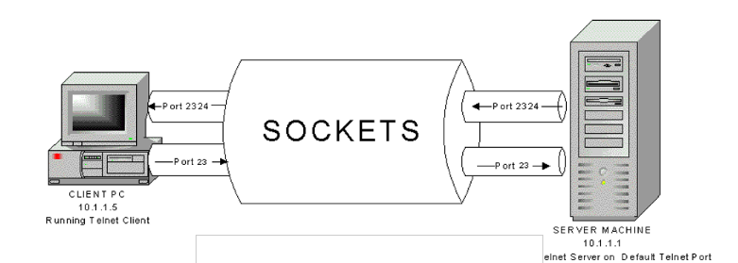
SOCKET PROGRAMMING

Slide 4
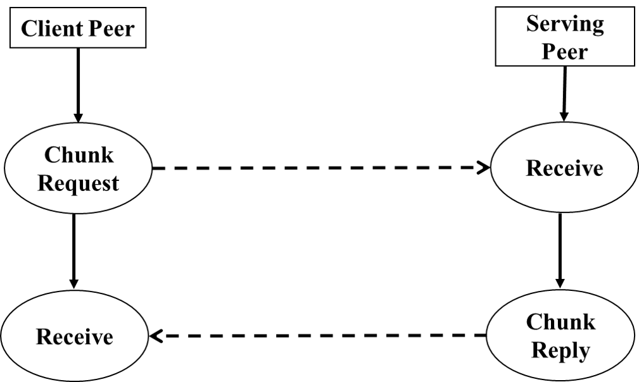
P2P ARCHITECHTURE

Slide 5
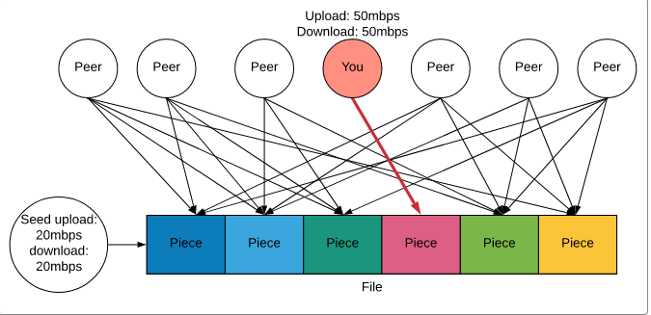
PIECE SELECTION ALGORITHM

Slide 6
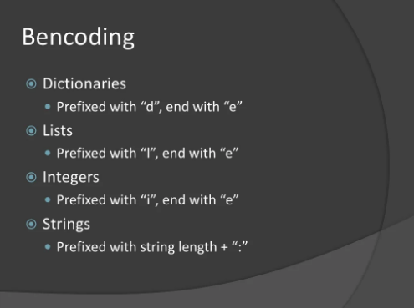

Slide 7
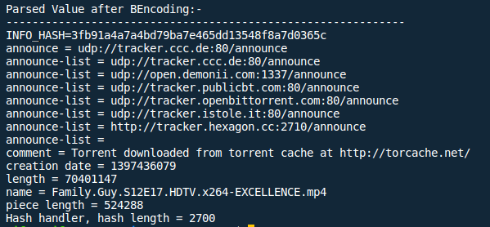

Slide 8
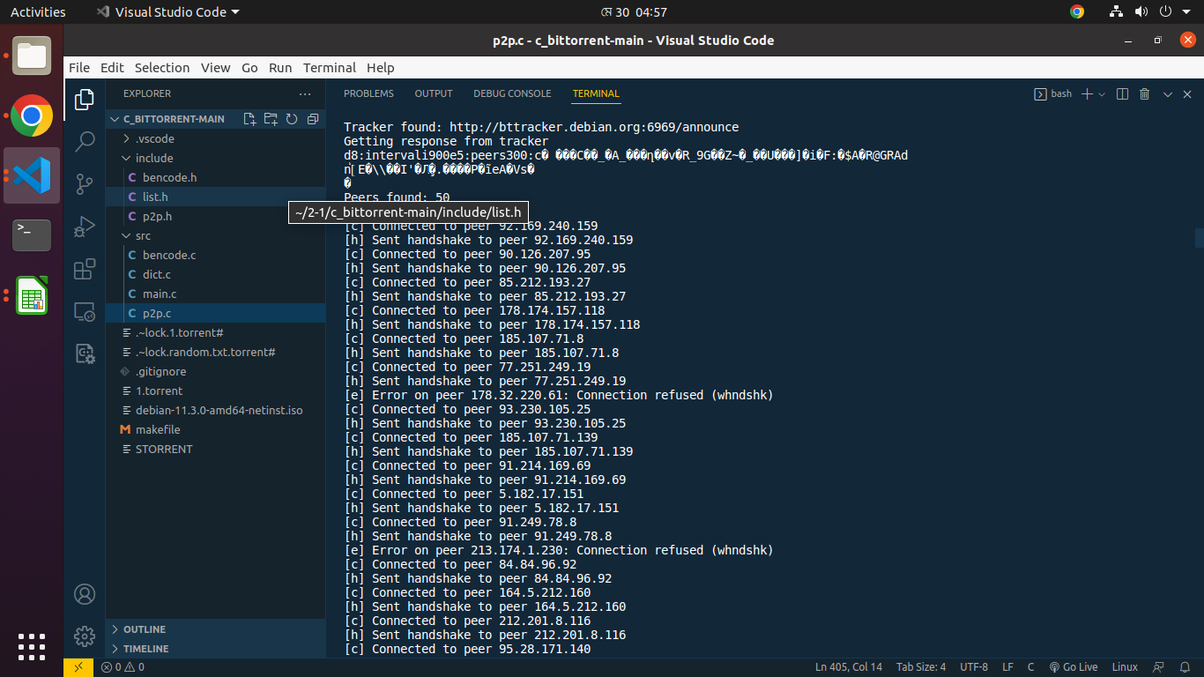
CONNECTED & HANDSHAKE

Slide 9
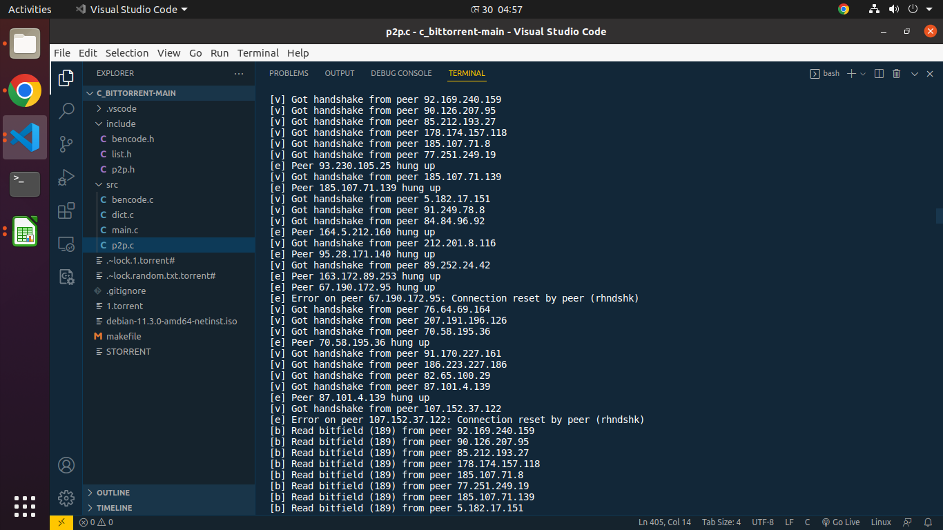
BITFIELD READ AND ERROR READ

Slide 10
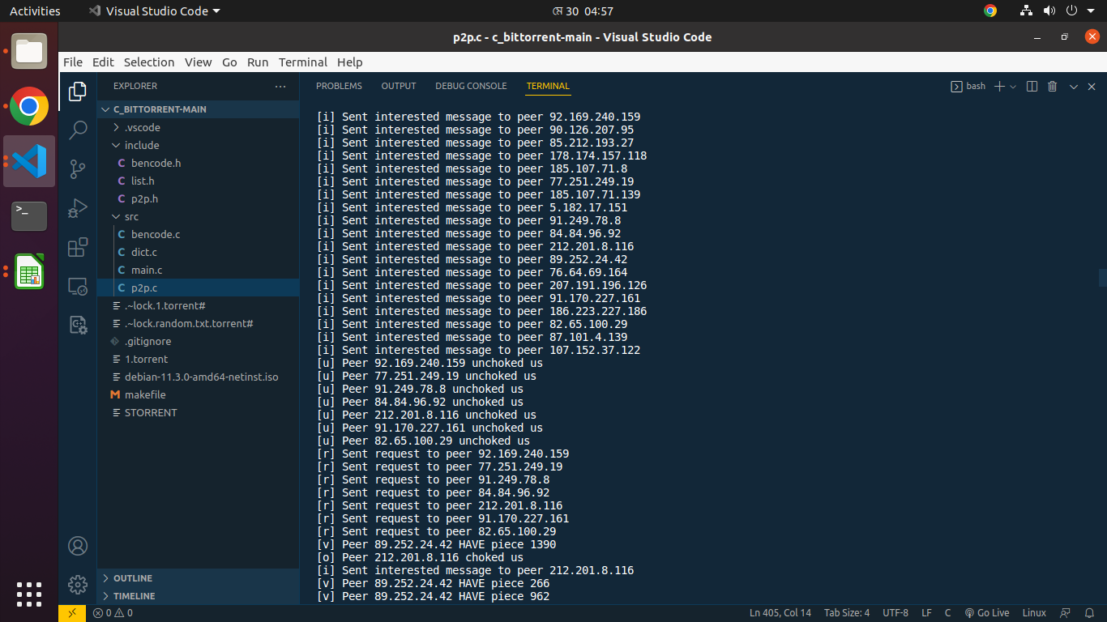
INTERESTED & UNCHOKED

Slide 11
CHALLENGES AND SOLUTIONS
Multiple Header
File compilation
MAKEFILE
Different
Encoding
System
Read Some
Thesis Paper

Slide 12
Learned
Some
Networking
Concepts
Such as
TCP,UDP
Socket
Programming
By learning the
Workings of Client
Server Architecture
P2P Architechture

Slide 13
My Github Repository link : https://github.com/SifatSikder/spl-1-storrento
Thank You

